Slide 1
C++ Programming Today 2nd Edition By Barbara Johnston Chapter 5
Instructor: <Instructor Name>
Lecture Slides by Kelly Montoya and Rob Garner

Slide 2
Overview
Data Variables and Memory
Pointers
Returning multiple values from functions
References
Why Pointers are Important
Queue Class
Common Errors With Pointers and References
File IO

Slide 3
References
Describe how to use references instead of pointers.

Slide 4
Functions and References
The C++ language streamlined the reference (address passing) concept.
C++ provides programmers with a call by reference technique for passing a variable’s address to a function that uses reference parameters.
A reference parameter is an address; it is implied though not plainly expressed as an address.

Slide 5
Functions and References
In the call by reference with reference parameter passing technique, the function prototype and function header line contain reference parameters— the & is used instead of the *.
The & operator in the prototype and function header line is saying “Reference” (as opposed to “Pointer”).

Slide 6
Functions and References
In the call statement, just the variable name is used; you do not need to use the & operator.
In this new type of call by reference, the addresses are passed to the called function and it accesses the calling function’s data.

Slide 7
Functions and References
Reference parameters employ the reference operator, &, in the function declaration.
The & operator is used in the function prototype and function header line.
The call statement has the variable names in it, but their addresses are being passed to the function.
Here is the AskForXandY program using references.
Notes:
Program 5-6 uses reference parameters in its Ask function.

Slide 8
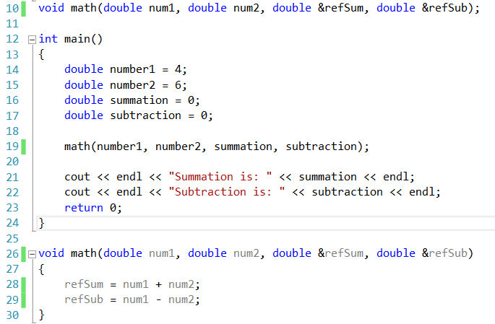
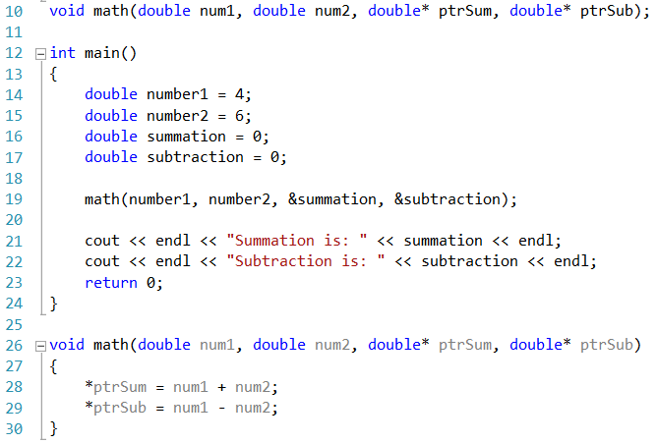
REFERENCES
POINTERS

Slide 9
Functions and References
//prototype using 2 references
void AskForXandY(int &rX, int &rY);
int main()
{
int x,y; //the call uses the var names
//but addresses are passes
AskForXandY(x, y); //var names here
//rest of main
}
void AskForXandY(int &rX, int &rY)
{
cout << "\n Enter 2 ints";
cin >> rX >> rY;
}
The & operator is also used in the function prototype.
The call statement has the variable names in it, but their addresses are being passed to the function.
Reference parameters employ the reference operator, &, in the function declaration.
Notes:
Taken from Program 5-8.

Slide 10
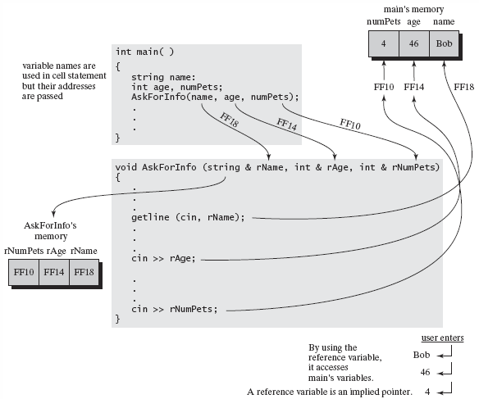
In a call by reference using references, the variable names are placed in the
call statement. Their addresses are passed to the function’s reference
parameters. When using the reference variable names, it accesses
main’s variables directly.

Slide 11
Reference Parameter Limitations
You may not reference another reference. (It is possible to have a pointer to a pointer.)
A reference variable must be initialized when declared if it is not part of a function parameter list, or if it is not a return value or class member.
It is not possible to create a pointer to a reference or to create an array of references.
Notes:
Program 5-7 demonstrates pointers and references together.

Slide 12
Why Pointers are Important
Explain why pointers are important.

Slide 13
Why Pointers Are Important
First, we introduce arrays in the next chapter. In order to understand fully the mechanism for passing arrays to functions, you need to understand what a pointer is.
Often, in C++ reference documents, you’ll see the * in the data type description for arrays.
Secondly, pointers are required in order to have your program perform dynamic memory allocation.

Slide 14
Why Pointers Are Important
When you take an Advanced C++ course, you’ll being using dynamic memory allocation and pointers!
Dynamic memory allocation is the technique where your program reserves memory while it runs instead of reserving memory statically.
C++ gives you an address of the memory it reserved “on the fly” as your program runs.
Pointers are used to hold these memory addresses.
Notes:
Program 5-7 uses pointers and references together.

Slide 15
References Demo
Demonstrate how to use references.

Slide 16
Queue Class
Demonstrate how to use the Queue class.

Slide 17
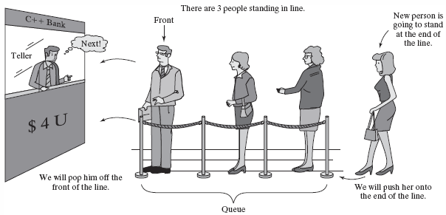
The queue Class
C++ provides a queue class, which models a FIFO (First in First out) line.

Slide 18
A queue Class gives you the tools to build a “line” in your program.
You have to make a queue object, specifying what type of data is held in the line.
You “push” data into the end of the line, and “pop” data off the front of the line.
It works exactly as you’d expect a well-behaved line to work. (No cuts! ;-).
Show prog 5-8
Notes:
Program 5-7 demonstrates pointers and references together.

Slide 19
Filling a queue
//fill the line with random numbers
#include <queue> //needed for a queue
using namespace std;
int main()
{
queue<int> numberLine;
for(int n = 0; n < 100; ++n)
{
int ran = rand();
numberLine.push(ranNumber);
}
}
Notes:
Taken from Program 5-8

Slide 20
BankLine Program
//The BankLine program models a line
//of people waiting for the teller
//use references with functions
int ShowMenu();
void ShowLineInfo(queue<string> &rLine);
void AddToTheLine(queue<string> &rLine);
void ServeFirst(queue<string> &rLine);
int main()
{
cout << "\n Welcome to the C++ Bank ";
queue<string> bankLine; // make queue
// menu code
} // end of main()
Note: bankLine is passed to the functions by address and called rLine.
Notes:
Taken from Program 5-8

Slide 21
BankLine Program
void AddToTheLine(queue<string> &rLine)
{
string name;
cout << "\n Who do we add to the end of the line? ";
getline(cin, name);
//Use push() function to push the person
//onto the end of the queue.
rLine.push(name);
}
Each time this function is used, someone is added to the back of the line.
Notes:
Taken from Program 5-8.

Slide 22
BankLine Program
void ServeFirst(queue<string> &rLine)
{
//check if line is empty or not
if(rLine.empty() == true)
{
cout << "\n No one in line, let's have a coffee break.";
}
else
{
cout << "\n NEXT! Now serving " << rLine.front();
//Now pop this person off of the queue.
rLine.pop();
}
}
Each time this function is used, someone is served off the front of the line.

Slide 23
Queue Class Functions
The queue class provides several functions that we’ll use as we work with queue objects.
Notes:
Program 5-8 demonstrates the queue class.

Slide 24
Overview
Data Variables and Memory
Pointers
Returning multiple values from functions
References
Why Pointers are Important
Queue Class
Common Errors With Pointers and References
File IO

